Slide 1
Lesson 7: Performance Management
Duration: 1 hour, 30 minutes
Performance Management
Slide 7- 1

Slide 2
Lesson 7 Topics
Lesson 7 Topics
Topic 1 – Performance Culture
Topic 2 – Key Roles
Topic 3 – Performance Management Process
Topic 4 – Exploring Performance Objectives
Topic 5 – How Performance is Evaluated
Additional performance management training can be found at http://dcips.dtic.mil/training.html
Performance Management
Slide 7- 2

Slide 3
Performance Culture
Performance Culture
With the intention of producing remarkable results, the Defense Intelligence performance culture embraces:
Innovation
Collaboration
Teamwork
Performance Management
Slide 7- 3

Slide 4
Key Roles
Key Performance Management Roles
Employee
Rating Official
Reviewing Official
PM PRA
Performance Management
Slide 7- 4

Slide 5
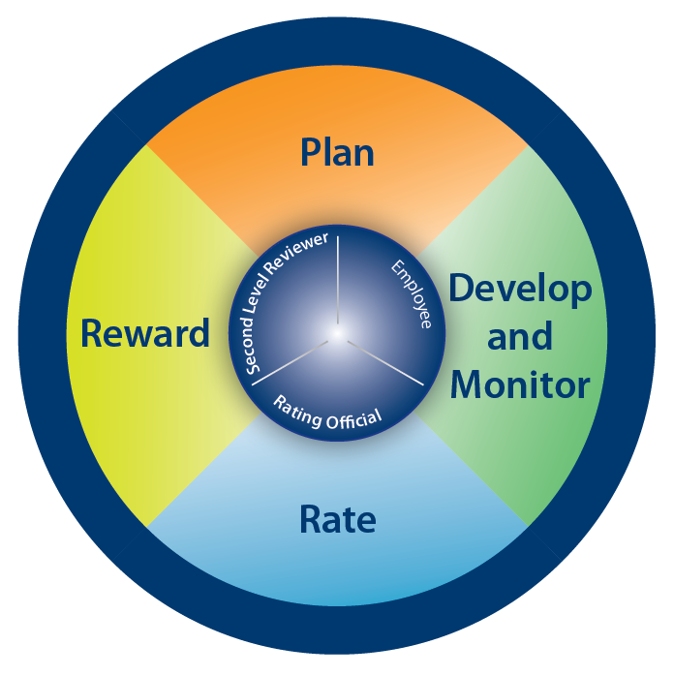
Performance Management Process
Performance Management Process
Performance Management
Slide 7- 5

Slide 6
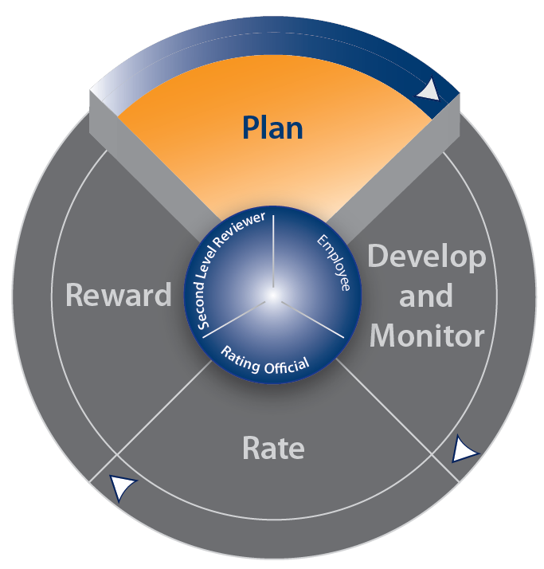
Performance Management Process
Performance Management Process
Performance Management
Slide 7- 6

Slide 7
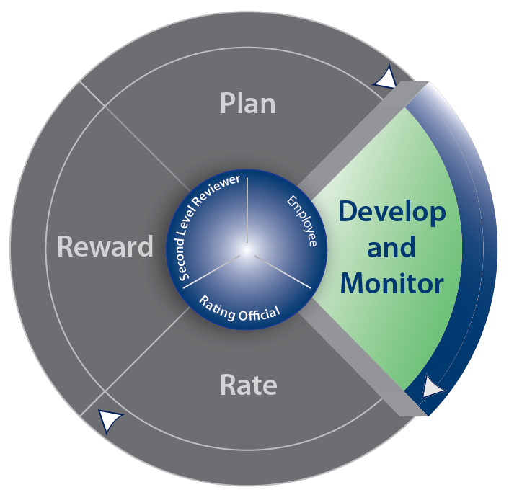
Performance Management Process
Performance Management Process
Performance Management
Slide 7- 7

Slide 8
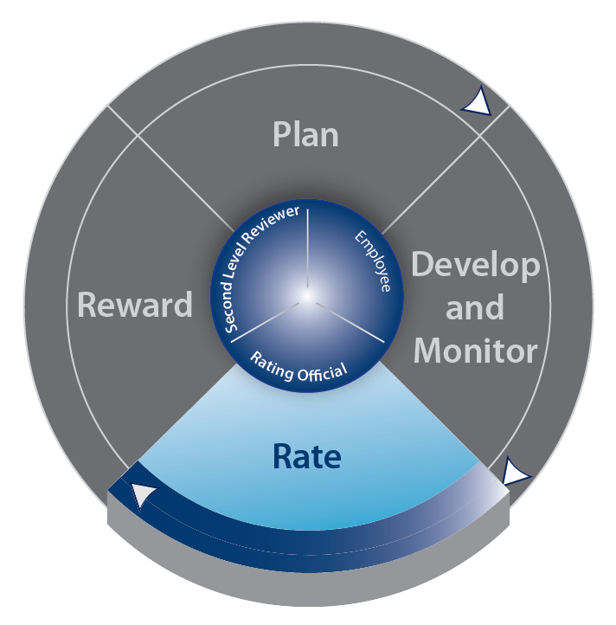
Performance Management Process
Performance Management Process
Performance Management
Slide 7- 8

Slide 9
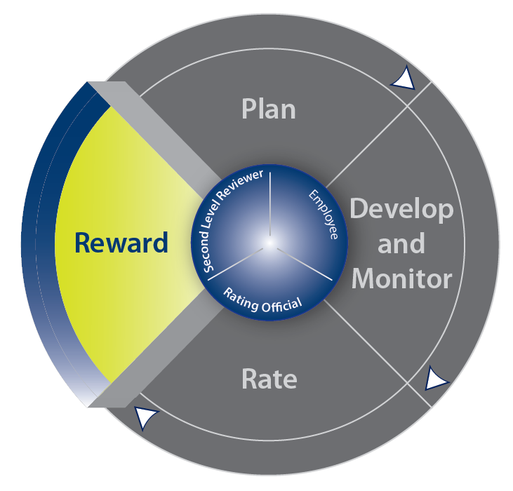
Performance Management Process
Performance Management Process
Performance Management
Slide 7- 9

Slide 10
Special Situations
Special Situations
Employee starts new position < 90 days from end of evaluation period
Employee performs in a new position or under another Rating Official
Employee is on a Joint Duty Assignment
Employee has < 90 days of civilian service
Employee is on an extended absence
Employee transfers to a new Component
Performance Management
Slide 7- 10

Slide 11
Value of Performance Objectives
Value of Performance Objectives
Aligns work with mission and organizational goals
Communicates the major work to be accomplished
Sets a baseline for successful performance
Helps to measure work
Forms the basis for ratings
Helps employees see how their performance contributes to organizational results
Performance Management
Slide 7- 11

Slide 12
What are Performance Objectives?
Performance Objectives Are:
Not task or position descriptions
Large-bucket items and not the small daily job tasks
A description of a future situation
Appropriate for the employee’s position and work level
Written at the “Successful” level and evaluated against the standards
Achievable within the evaluation period
Performance Management
Slide 7- 12

Slide 13
Use of Performance Objectives
Use of Performance Objectives
Well-written performance objectives are critical to the success of DCIPS because they form the basis for performance conversations and decisions in every phase of the performance management process
Performance Management
Slide 7- 13

Slide 14
Cascading Performance Objectives
Cascading Performance Objectives
Defense and National Intelligence Goals
Component
Division
Work Unit
Employee
Performance Management
Slide 7- 14

Slide 15
SMART Performance Objectives
SMART Performance Objectives
Specific
Measurable
Achievable
Relevant
Time-bound
Performance Management
Slide 7- 15

Slide 16
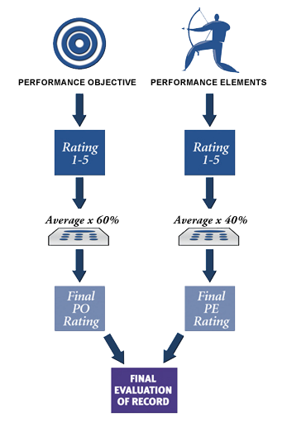
Evaluating Performance
Evaluating Performance
Performance Management
Slide 7- 16

Slide 17
The Evaluation Process
The Evaluation Process
DCIPS evaluates performance based on what an employee accomplishes (performance objectives) as well as how it is accomplished (performance elements)
Performance Management
Slide 7- 17

Slide 18
Rating Descriptors
Rating Descriptors
The Performance Objectives and Element Rating Descriptors – DCIPS Volume 2011, Table 1
General Standards
Performance Rating | Objectives Descriptors | Element Descriptors
SUCCESSFUL (3) | The employee achieved expected results on the assigned objective. At the summary level, the employee achieved expected or higher results overall and on most assigned objectives with an average rating within the “Successful” range in Table 2. | The employee fully demonstrated effective, capable performance of key behaviors for the performance element. At the summary level, the employee demonstrated effective, capable performance or higher on key behaviors on most performance elements with an average rating within the “Successful” range in Table 2.
Note: This is sample of the Performance Objectives and Elements Rating Descriptors table. Please refer to Reference Guide Tab 11 for the complete table.
Performance Management
Slide 7- 18

Slide 19
IC Performance Standards
Sample of the IC Performance Standards
Entry/Developmental Employees in Professional Work Category
Accountability for Results
Successful |  | Outstanding
Accepts responsibility for own actions, whether or not they are successful. Adheres to schedules and, with guidance, organizes and prioritizes own tasks to complete assignments in a timely and effective manner, making adjustments as needed. With guidance, gains a basic understanding of available resources and the process for acquiring the resources needed to accomplish own work; uses time and resources in an efficient manner. Takes action to achieve meaningful results in support of organizational goals and objectives. |  | Proactively takes responsibility for own actions, even when faced with challenges or criticism. Puts forth effort to overcome obstacles and accomplish assignments; takes appropriate initiative to make adjustments to plans, goals, and priorities to meet deadlines. Takes initiative to expand knowledge of available resources and the process for acquiring them; makes meaningful suggestions for increasing efficiency in the use of resources. Consistently takes action to achieve outcomes and results that are superior in quality, quantity, and/or impact to what would ordinarily be expected at this level.
Performance Management
Slide 7- 19

Slide 20
Evaluating Performance Objectives
Evaluating Performance Objectives
Two-Step Rating Process:
Step 1 - Rating Official reviews the general standards, the performance plan, and the self-report of accomplishments to determine the rating for each performance objective
Step 2 - Rating Official uses the Component’s automated performance evaluation tool to calculate the average for all individual performance objective ratings. The tool then multiplies that average by 60%
Performance Management
Slide 7- 20

Slide 21
What are Performance Elements?
Performance Elements Are:
Attributes of job performance that are significant to the accomplishment of performance objectives
Description of the manner in which the performance objectives and all of the employee’s work results were achieved (the “how”)
Standardized throughout the Intelligence Community
Rated separately
Performance Management
Slide 7- 21

Slide 22
The Performance Elements
The Performance Elements
Employees | Managers/Supervisors
Accountability for Results | Accountability for Results
Communication | Communication
Critical Thinking | Critical Thinking
Engagement and Collaboration | Engagement and Collaboration
Personal Leadership and Integrity | Leadership and Integrity
Technical Expertise | Managerial Proficiency
Note: The four elements inside the yellow box are the same for employees and managers/supervisors; the remaining two elements in each column are specific as to whether an individual is an employee or manager/supervisor.
Performance Management
Slide 7- 22

Slide 23
Evaluating Performance Elements
Evaluating Performance Elements
Two-Step Rating Process:
Step 1 - Rating Official reviews the general standards, the performance plan, and the self-report of accomplishments to determine the rating for each performance element
Step 2 - Rating Official uses the Component’s automated performance evaluation tool to calculate the average for all individual performance element ratings. The tool then multiplies that average by 40%
Performance Management
Slide 7- 23

Slide 24
Evaluating Performance
Evaluating Performance
Performance Management
Slide 7- 24

Slide 25
Evaluating Performance
Evaluating Performance
Performance Management
Slide 7- 25

Slide 26
Evaluating Performance Exercise
Evaluating Performance Exercise
Performance Objective | Performance Objective Rating | Performance Elements | Performance Element Rating
A | 3 | Accountability for results | 4
B | 3 | Communication | 4
C | 3 | Critical thinking | 3
 |  | Engagement and collaboration | 3
 |  | Leadership | 3
 |  | Managerial proficiency | 3
Final: | ? |  | ?
Final Performance Evaluation of Record = ?
Performance Management
Slide 7- 26

Slide 27
Answers:
Evaluating Performance Exercise
Answers: Evaluating Performance Exercise
Performance Objective | Performance Objective Rating | Performance Elements | Performance Element Rating
A | 3 | Accountability for results | 4
B | 3 | Communication | 4
C | 3 | Critical thinking | 3
 |  | Engagement and collaboration | 3
 |  | Leadership | 3
 |  | Managerial proficiency | 3
Final: | 3.0 x 60% = 1.8 |  | 3.3 x 40% = 1.3
Final Performance Evaluation of Record = 3.1 = 3 = “Successful”
Performance Management
Slide 7- 27

Slide 28
Reconsideration Process
Reconsideration Process
Two reconsideration processes are available to DCIPS employees:
Informal Reconsideration
Formal Reconsideration
Performance Management
Slide 7- 28

Slide 29
Lesson 7 Review
Lesson 7 Review
Topic 1 – Performance Culture
Topic 2 – Key Roles
Topic 3 – Performance Management Process
Topic 4 – Exploring Performance Objectives
Topic 5 – How Performance is Evaluated
Slide 7- 29
Performance Management
Slide 3- 2

